Slide 1

CAPSTONE PROJECT
II
Yes bank stock
Closing price
prediction
ASHUTOSH MAURYA

Slide 2
CONTENTS
INTROCUTION
DATA UNDERSANDING EDA
DATA TRANSFORMING, SPLITING AND NORAMLIZATION
MODEL BUILDING
EVALUATION MATRICS COMPARISON
CHALLENGES
CONCLUSION

Slide 3

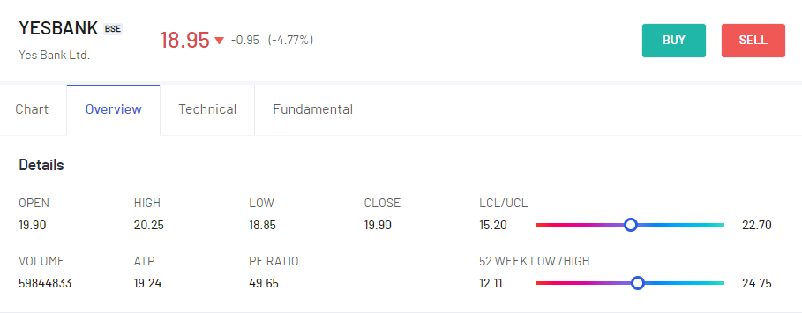
INTRODUCTION
LET’S PUT THE LIGHT ON STOCK MARKET ACTIVITIES.
A Stock or share (also known as a company’s “equity”) is a financial instrument that represents ownership in a company.
There are some following features-
Date: It denotes date of investment done (in our case we have month and year).
Open: Open means the price at which a stock started trading when the opening bell rang.
High: High refer to the maximum prices in a given time period.
Low: Low refer to the minimum prices in a given time period.
Close: Close refers to the price of an individual stock when the stock exchange closed for the day.
Yes Bank is a well-known bank in the Indian financial domain. Since 2018, it has been in the news because of the fraud case involving Rana Kapoor. Owing to this fact, it was interesting to see how that impacted the stock prices of the company and whether Time series models or any other predictive models can do justice to such situations. This dataset has monthly stock prices of the bank since its inception and includes closing, starting, highest, and lowest stock prices of every month. The main objective is to predict the stock’s closing price of the month.

Slide 4
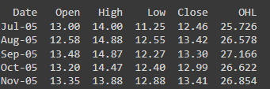
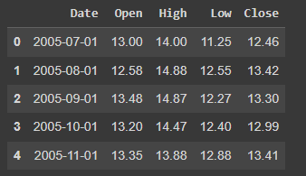
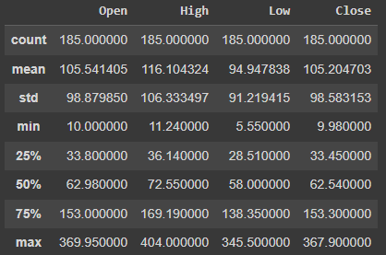
DATA UNDERSANDING EDA
We have Yes bank stock price dataset in this project. In the dataset, we have 185 rows and 5 columns.
Five columns are Date, Open, High, Low & Close
This data is in string object type. Data need to convert in date time object.
Summary of the data
No Null and Duplicate value.

Slide 5
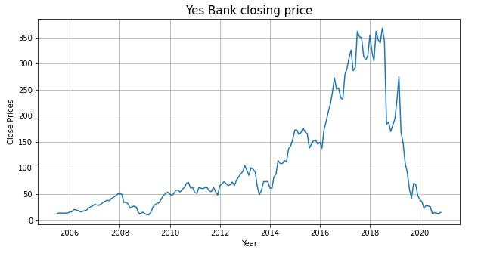
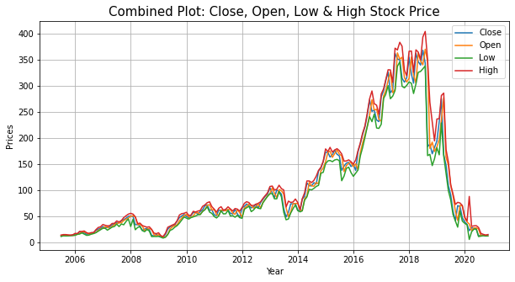
EDA
Here, Yes bank opening price and Yes bank closing price has same result. Opening price started increasing in year 2014 and it was at peak in year 2018. But after 2018 it started falling down continuously and came at 0 in year 2020 same as Yes bank closing price.
stock price decreasing largely due to Rana Kapoor's case.
All the prices shows almost similar trends with each other.
Which means that this features may be strongly correlated with each other.
Plotting close price vs date
Combined Line Plot for all features with respect to date.

Slide 6
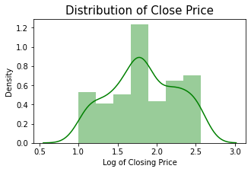
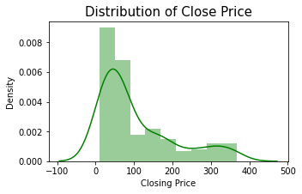
NORMAL DISTRIBUTION
Distribution plot of closing price is right skewed.
To make it normal distribution apply log transformation.

Slide 7
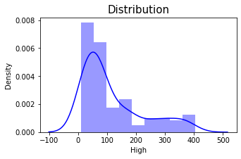
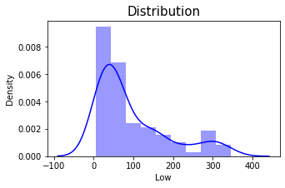
From the above graph we can conclude the point that the stock of the Yes bank falls down after the 2018 and it is not beneficial for investors to invest their money.
Plotting distribution for each of numerical features
Plotting distribution for each of numerical features by applying log transformation

Slide 8
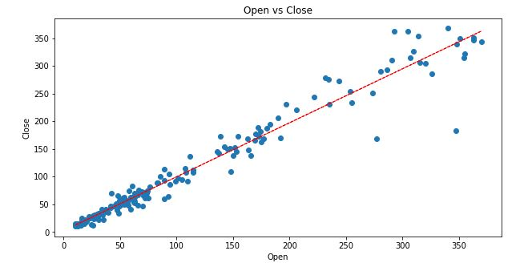
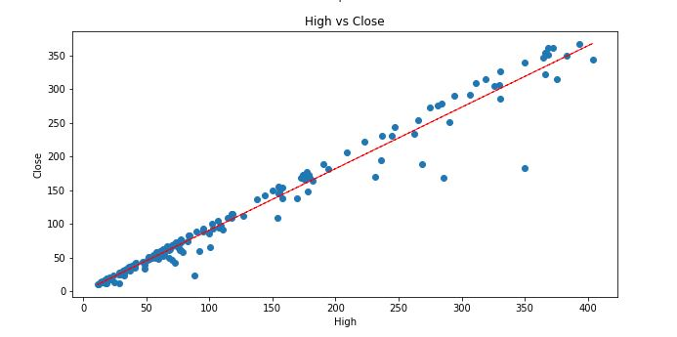
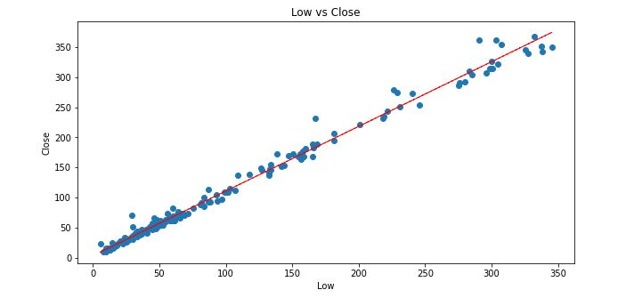
In all scatter plot we can conclude that bivariate analysis shows high correlation of close price with other features, and other features also shows correlation between each other

Slide 9
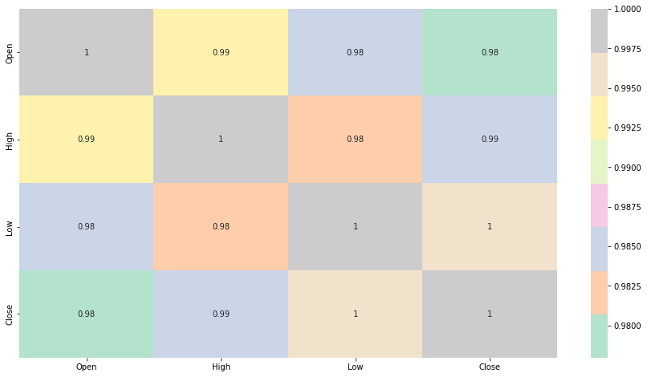
From the above heat map we can conclude that all the features showing high correlation between each other.

Slide 10
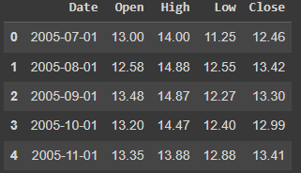
DATA TRANSFORMING, SPLITING AND NORAMLIZATION
Creating a new feature based on average of other features in the dataset
X = Independent Variable values
y = Dependent Variable values
Splitting our data into Dependent and Independent Variables
Data must be normal distributed. So applying normalization on X & Y.
Normalization -Data transformation
Train(80%) & Test(20%) Split
Splitting Data into Testing and Training Datasets
shape of training dataset- (148,3)
shape of testing dataset-(37,2)

Slide 11
MODEL BUILDING
Regression
Regression model returns an equation that determines the relationship between the independent variables and the dependent variable.
1- Linear Regression
A linear regression between a dependent (y) (in our case is close price) and or more independent (in our case open, low, high) variables, hence called as linear regression.
Train accuracy of linear regression model is 0.815
Test accuracy of linear regression model is 0.823
Evaluation Metrics of Linear Regression
Test Performance of linear regression model
MSE : 0.032 RMSE : 0.178 MAE : 0.151 MAPE : 0.095 R2 : 0.823

Slide 12
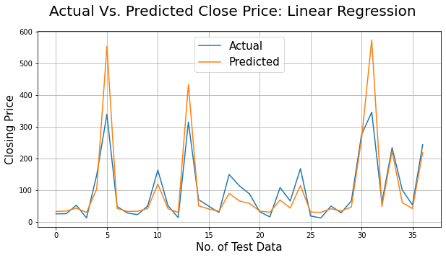
Linear Regression: Actual Vs. Predicted
Actual Price vs. Predicted Price for Linear Regression Plotting

Slide 13
2- Lasso Regression
Lasso regression analysis is a shrinkage and variable selection method for linear regression models. The goal of lasso regression is to obtain the subset of prediction that minimizes o the model quantitative response variable. The lasso does this by imposing to shrink toward zero.
Train accuracy of lasso regression model is 0.814
Evaluation Metrics of Lasso Regression
Test Performance of lasso regression model
MSE : 0.032 RMSE : 0.179 MAE : 0.152 MAPE : 0.096 R2 : 0.82

Slide 14
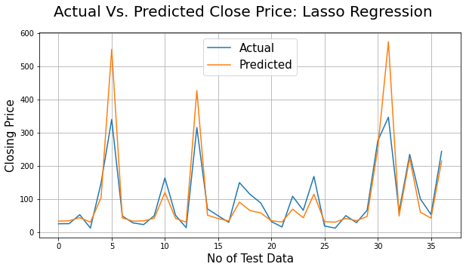
Lasso Regression: Actual Vs. Predicted
Actual Price vs. Predicted Price for Lasso Regression Plotting

Slide 15
Cross Validation on Lasso Regression
In cross validation we can perform our model on the new dataset or we can say test dataset. So that we can check our model performance.
So the conclusion, the R squared value for the test data was 82%. This is almost same as in the score from the training dataset which proves that in a dataset we achieve the best fit model.
Evaluation Metrics of Lasso Regression after Validation
Test Performance of lasso regression model after validation
MSE : 0.032 RMSE : 0.18 MAE : 0.153 MAPE : 0.097 R2 : 0.819

Slide 16
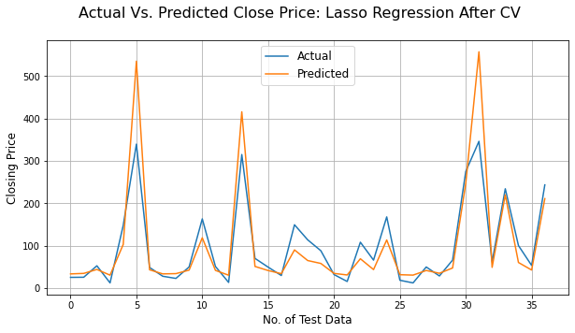
Lasso Regression After Validation: Actual Vs. Predicted
Actual Price vs. Predicted Price for Lasso Regression after Validation Plotting

Slide 17
3-Ridge Regression
Ridge regression is a model tuning method that is used to analyse any data that suffers from multicollinearity. This method performs L2 regularization. When the issue of multicollinearity occurs, least-square are unbiased, and variance are large, this results in predicted values being far away from the actual values.
Train accuracy of Ridge regression model is 0.815
Evaluation Metrics of Ridge Regression
Test Performance of ridge regression model
MSE : 0.032 RMSE : 0.178 MAE : 0.151 MAPE : 0.095 R2 : 0.82

Slide 18
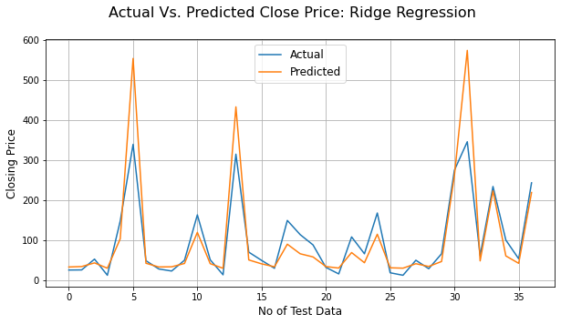
Ridge Regression After Validation: Actual Vs. Predicted
Actual Price vs. Predicted Price for Ridge Regression after Validation Plotting

Slide 19
Cross Validation on Ridge Regression
In cross validation we can perform our model on the new dataset or we can say test dataset. So that we can check our model performance.
So the conclusion, the R squared value for the test data was 82%. This is almost same as in the score from the training dataset which proves that in a dataset we achieve the best fit model.
Evaluation Metrics of Ridge Regression after Validation
Test Performance of lasso regression model after validation
MSE : 0.033 RMSE : 0.18 MAE : 0.153 MAPE : 0.097 R2 : 0.817

Slide 20
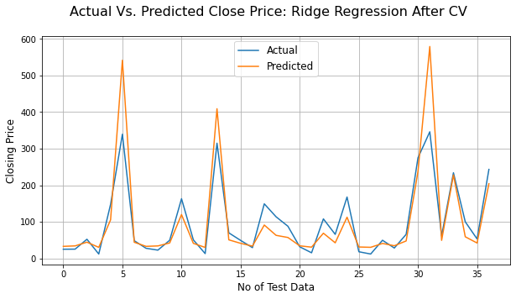
Ridge Regression After Validation: Actual Vs. Predicted
After implementing the best parameter best R^2 score we have 82% for Ridge regression model.
Actual Price vs. Predicted Price for Ridge Regression after Validation Plotting

Slide 21
3-Elastic Net
The elastic net is a regularized regression method that linearly combines the L1 and L2 penalties of the lasso and ridge methods..
Train accuracy of Elastic Net regression model is 0.796
Evaluation Metrics of Elastic Net Regression
Test Performance of Elastic Net regression model
MSE : 0.036 RMSE : 0.191 MAE : 0.157 MAPE : 0.102 R2 : 0.796

Slide 22
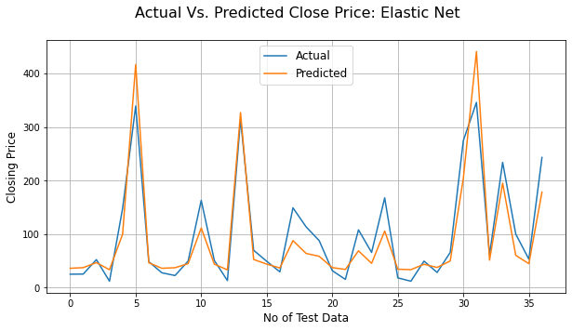
Elastic Net Regression After Validation: Actual Vs. Predicted
Actual Price vs. Predicted Price for Elastic Net Regression after Validation
Plotting

Slide 23
Cross Validation on Elastic Net Regression
In cross validation we can perform our model on the new dataset or we can say test dataset. So that we can check our model performance.
So the conclusion, the R squared value for the test data was 82%. This is almost same as in the score from the training dataset which proves that in a dataset we achieve the best fit model.
Evaluation Metrics of Elastic Net Regression after Validation
Test Performance of Elastic Net regression model after validation
MSE : 0.032 RMSE : 0.18 MAE : 0.153 MAPE : 0.097 R2 : 0.819

Slide 24
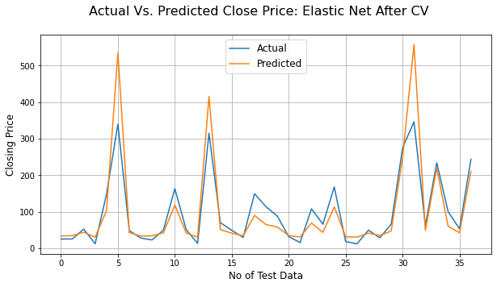
Elastic Net Regression After Validation: Actual Vs. Predicted
After implementing the best parameter best R^2 score we have 79% for Ridge regression model.
Actual Price vs. Predicted Price for Elastic Net Regression after Validation
Plotting

Slide 25
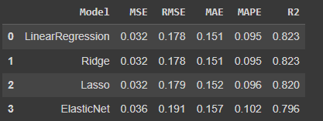
EVALUATION MATRICS COMPARISON

Slide 26
CHALANGES
1. Small dataset and that dataset is in improper manner.
2. In data cleaning, we had to change into proper dd/mm/yyyy format.
3. All the features showing high correlation between each other.

Slide 27
CONCLUSION
1. We got a maximum accuracy of 82%.
2. Linear, lasso and ridge regression show almost same R squared values.
3. Whereas elastic net model shows lowest R squared value and high MSE,RMSE, MAE & MAPE.
4. Close, Open and high price of stock are strongly correlated with each other.

Slide 28
Thank You
Q&A

